Slide 1

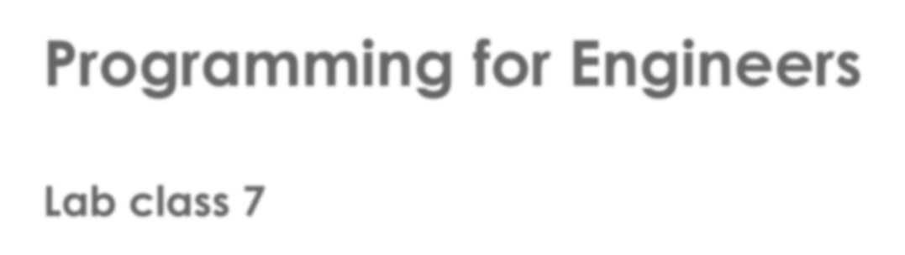
Programming for Engineers
Lab class 7

Slide 2

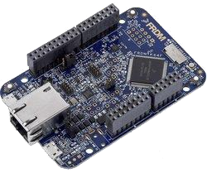
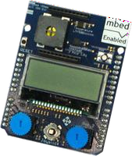
Previously
From C to C++
 Procedural vs. object-oriented programming
 Objects and classes
Intelligent agents / Freescale Freedom platform
 Intelligent agents / Hierarchy of control revisited
 The ARM FRDM-K64F controller
 IoT Application shield
Web-based IDE and compiler https://os.mbed.com
 Started developing a simple action game

Slide 3

Today
Programming in C/C++
 Some fundamental concepts of Object-orientation
 Abstraction and Modularisation
 Information hiding and encapsulation
 Interface and implementation
 Software design
 The linguistic method to defining classes and their members
 How to create a basic requirements specification

Slide 4

Abstraction and Modularisation
Abstraction
… is the ability to ignore the implementation details of parts of a program in order to focus attention on the higher level aspects of the problem that is to be solved.
Modularisation
… is the process of dividing a problem into well-defined parts, which can then be implemented and examined separately, and which interact in well-defined ways.

Slide 5
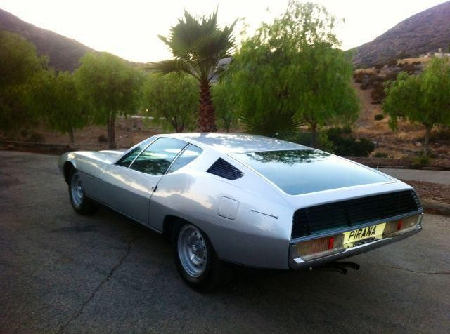

Abstraction and Modularisation
What does that mean?
 Divide and conquer a problem
 Identify objects and generalise into classes
 Use related objects to construct modules
Images: motortrend.com
A car…

Slide 6
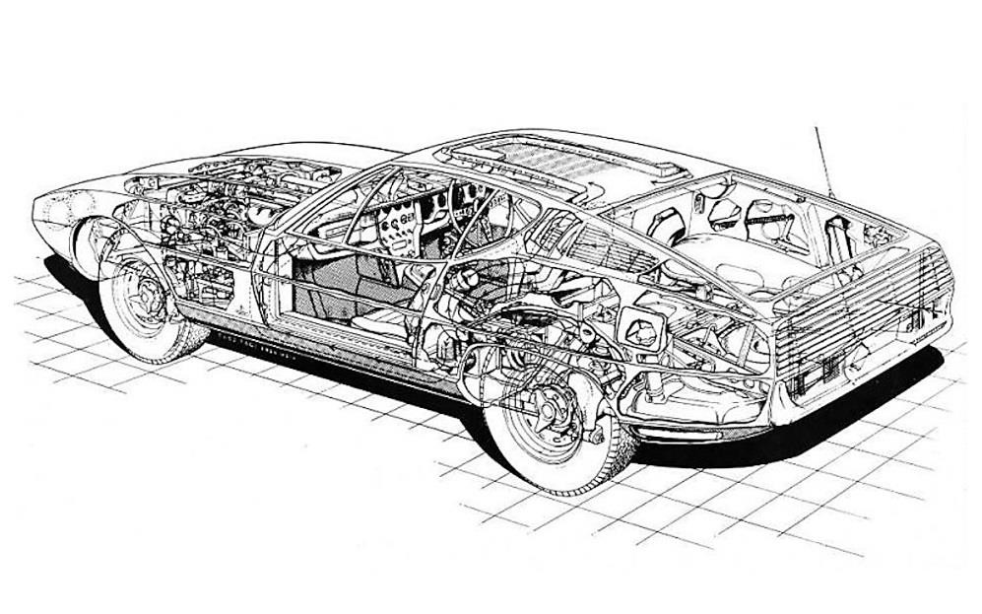
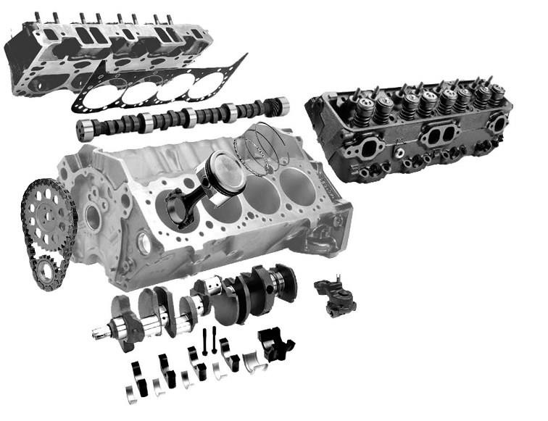
Abstraction and Modularisation
What does that mean?
 Divide and conquer a problem
 Identify objects and generalise into classes
 Use related objects to construct modules
Why do it?
 Hide complexity
 Makes it easier to think about
the problem as a whole
 Encapsulate design decisions
Image: motortrend.com
… is made of
many parts
Image: electricalpowerengineering.blogspot.com

Slide 7
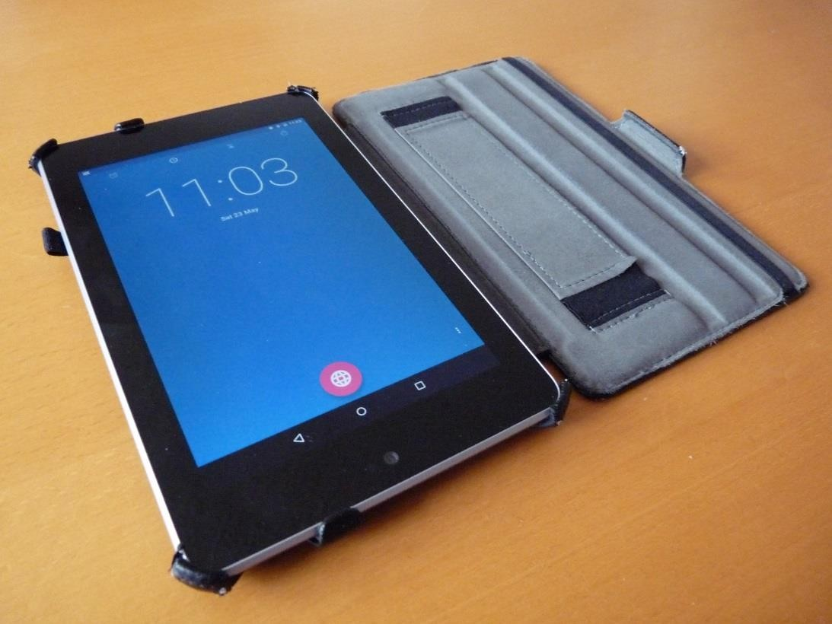
Abstraction and Modularisation
A simpler example:

Slide 8



Abstraction and Modularisation
A digital clock:
Shall we create one four-digit display?
or two two-digit displays?
What if we wanted to add a display for
“seconds” sometime later?

Slide 9
Abstraction and Modularisation
NumberDisplay class:
class NumberDisplay { private:
int limit;
int value;
public:
NumberDisplay() {
value = 0;
limit = 0;
}
void setLimit(int li) { limit = li;
}
<other member functions>
}
 Let’s have two separate number displays
 Both are instances of the same class

Slide 10

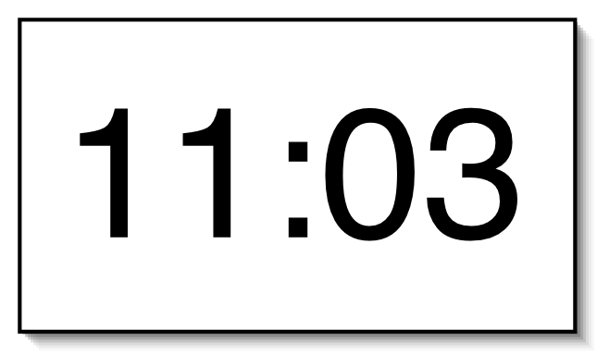

Abstraction and Modularisation
ClockDisplay class:
class ClockDisplay { private:
NumberDisplay hours; NumberDisplay minutes;
<member functions>
}
 This class brings the two number displays together to create a clock
 The two NumberDisplay objects are data members of this class

Slide 11

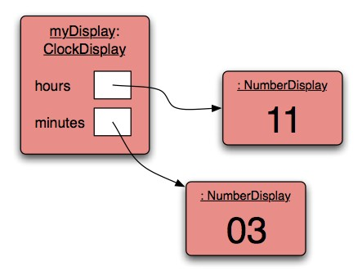


Object interaction
Object relationships
class ClockDisplay { private:
NumberDisplay hours; NumberDisplay minutes;
<member functions>
}

Slide 12
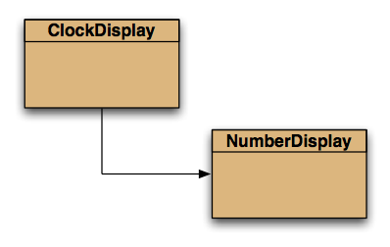
Object interaction
Class dependencies
class ClockDisplay { private:
NumberDisplay hours; NumberDisplay minutes;
<member functions>
}
ClockDisplay depends on NumberDisplay

Slide 13

Member function (method) calls
Internal calls
 Within the same class, member functions can be called by simply stating their name and parameter list as an instruction, e.g.
Parameters
class NumberDisplay
{
private int limit;
private int value;
...
void increment()
{
value = (value + 1) % limit;
}
}
Member
function
increment();
 No object name is required

Slide 14
Member function (method) calls
External calls
 If a class or function uses objects from classes specified elsewhere, their functions can be called by stating
the identifier of the object followed by the dot operator and the method name and parameters, e.g.:
hours.increment();
Identifier
Dot operator
class ClockDisplay {
private:
NumberDisplay hours; NumberDisplay minutes;
...
public:
void tick() { minutes.increment(); if(minutes.getValue() == 0)
hours.increment();
}
}
Method name + parameters

Slide 15

Information hiding & encapsulation
Why hide and encapsulate information?
 Information hiding and encapsulation enforce abstraction and modularisation:
We can more easily construct complex software and prevent bugs
 Every object manages its own state
 Getter and setter functions control access to private data members
 The internal implementation is not relevant to most users – only the interface is (i.e., the public functions of a class)

Slide 16

Interface & implementation
What is the difference?
 The interface of a class is the defined set of public functions (or methods) that
expose functionality to the outside (i.e., things we can “do” with an object)
 The implementation is the actual coding of the behaviour
 In C/C++, class definitions (interfaces) are often to be found in separate header
files (*.h, or alternatively, *.hpp)
 The implementation of these interfaces should then be made in *.cpp files of the same name or in our program (remember the scope operator ::)

Slide 17
Interface & implementation
Example: NumberDisplay.h (interface)
class NumberDisplay {
private: int limit; int value;
// data
public: NumberDisplay(); void setLimit(int); void increment(); int getValue(); void setValue(int);
// public methods (prototypes)
};

Slide 18
Interface & implementation
Example: NumberDisplay.cpp (implementation)
#include "NumberDisplay.h" NumberDisplay::NumberDisplay() {
value = 0;
setLimit(0);
}
void NumberDisplay::setLimit(int l) { limit = l;
}
void NumberDisplay::increment() { value = (value+1) % limit;
}
int NumberDisplay::getValue() {
return value;
}
void NumberDisplay::setValue(int v) { value = v; }

Slide 19

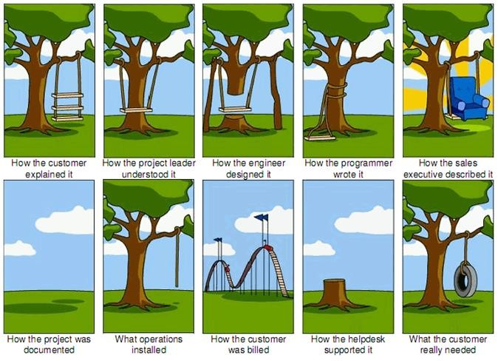
Planning a software project
Why we need a plan
 Communication can be tricky
 Clear objectives
 Clarity on functionality
 Meeting expectations

Slide 20
Planning a software project
A basic requirements specification
 Describe what you are trying to build or realise (objectives)
 Outline functional requirements (specific inputs, behaviours, and outputs)
 Outline non-functional requirements (softer factors: look & feel, speed, etc.)

Slide 21

OO Software Design
How do we decide which classes, data, and methods we need?
Object-orientation is a particular way of looking at and modelling our problem:
 Classes represent things or concepts
 Member data (variables) represent properties
 Member functions (methods) represent behaviour of these things
 The “linguistic method” can be useful for anyone not very experienced in
software engineering to come up with an initial program structure quickly

Slide 22
OO Software Design
Steps towards designing a software system
 Identify the main components and functions of your software
 Write down, in full sentences, a description of these components and what they do
 Initial candidates for classes in a system, and some of their data variables, can be
found in the nouns that you used to name elements of the software
“The multimedia database stores information about media items, such as their title
and rating. These items can be Audio-CDs, Films, and Games”.

Slide 23
OO Software Design
Steps towards designing a software system
 Identify the main components and functions of your software
 Write down, in full sentences, a description of these components and what they do
 Initial candidates for classes in a system, and some of their data variables, can be
found in the nouns that you used to name elements of the software
“The multimedia database stores information about media items, such as their title
and rating. These items can be Audio-CDs, Films, and Games”.

Slide 24
OO Software Design
Steps towards designing a software system
 Identify the main components and functions of your software
 Write down, in full sentences, a description of these components and what they do
 Required data members can sometimes be found around adjectives, and whatever
words come after phrases like “has/have a”, “contains a”, “returns”, “shows”, etc.
“Each film has a director and a title. The total runtime is stored as well, and there is
also a list of the actors that are in the film”.

Slide 25
OO Software Design
Steps towards designing a software system
 Identify the main components and functions of your software
 Write down, in full sentences, a description of these components and what they do
 Required data members can sometimes be found around adjectives, and whatever
words come after phrases like “has/have a”, “contains a”, “returns”, “shows”, etc.
“Each film has a director and a title. The total runtime is stored as well, and there is
also a list of the actors that are in the film”.

Slide 26
OO Software Design
Steps towards designing a software system
 Identify the main components and functions of your software
 Write down, in full sentences, a description of these components and what they do
 Prospective methods (member functions) in those classes can be identified by looking at the verbs in your description, as these often hint at what individual elements “do”.
“Users can list all items in the database, search for specific titles, and filter the results”.

Slide 27
OO Software Design
Steps towards designing a software system
 Identify the main components and functions of your software
 Write down, in full sentences, a description of these components and what they do
 Prospective methods (member functions) in those classes can be identified by looking at the verbs in your description, as these often hint at what individual elements “do”.
“Users can list all items in the database, search for specific titles, and filter the results”.

Slide 28

Practice time
Software requirements and design
Let’s say we wanted to build a digital clock for the ARM Freedom platform.
Outline the general function of a digital clock that has a display for hours, minutes, and seconds.
Specify the functional requirements of such a digital clock.
(What does the clock do? What are possible inputs, behaviours, and outputs?)
Think about non-functional requirements of this software.
Use the linguistic method with what you wrote in 1. to identify possible classes,
attributes, and methods

Slide 29

Building the clock
Open the development platform
 Go to https://os.mbed.com
 Log in and open the ”Compiler” IDE

Slide 30
Interface & implementation
In mbed, we can create our own libraries
 Right-click project and select “New library” – name it “ClockDisplay”
 Open the library folder
 There, create a new file ClockDisplay.h to specify the interface
 Now create another file ClockDisplay.cpp within the library to provide an
implementation for the interface.
 In your main.cpp, you just need to do #include “ClockDisplay.h” – this will locate interface and implementation.
Tip: You must also define and implement the NumberDisplay class, and include it in ClockDisplay.h (the latter depends on the former).

Slide 31
Practice time
Create a clock display on the ARM Freedom platform
1. Try and create elements of a simple clock display using a main.cpp and your
ClockDisplay library.
Tip: It may be easiest to clone and rename a project that uses the display library.
1. If you have time left, check out https://os.mbed.com/handbook/API-Documentation
for details on how to properly document your code files and libraries. Make sure you get to know relevant documentation keywords, such as @param or @returns

Slide 32

Designing Classes
Software is subject to permanent change
 Software is not like a novel that is written once and then remains unchanged
 Software is often extended, corrected, maintained, ported, adapted, …
 This is usually done by different people, and over longer time periods
 Software that can’t be updated and maintained will be thrown away eventually!

Slide 33
Designing Classes
Well-designed classes are
 Understandable
 Maintainable
 Reusable

Slide 34
Designing Classes
Assessing Code and Design Quality
 If we are to be critical of code quality, we need evaluation criteria
 There are some important concepts for assessing the quality of code:
 Code duplication
 Coupling
 Cohesion

Slide 35
Designing Classes
Code Duplication
 Having the same segment of code in an application more than once is often an
indicator of bad design
 It makes maintenance inefficient, because any changes we make to the code need to be duplicated as well
 This makes it easy for errors to slip into our code during maintenance
 We want to avoid code duplication where possible

Slide 36
Designing Classes
Coupling
 Coupling is a measurement of the links between separate units of a program
 These units can be classes, methods or entire modules (packages)
 A class diagram provides (limited) hints at the degree of coupling

Slide 37
Designing Classes
DO: Loose Coupling
 The implementation of one unit remains largely independent of that of another
 Classes and methods require minimal knowledge of each others’ internals to work
 Loosely coupled code is easier to understand and maintain
 Encapsulation helps to reduce coupling between the classes of a program
 We aim for loose coupling

Slide 38
Designing Classes
AVOID: Tight Coupling
 If a class relies very closely on the implementation details of another class, then
we say they are tightly coupled
 That means if we change the implementation of one class, we are very likely to also have to make changes to the other class!
 Tightly coupled code is harder to understand in isolation because there are many
interdependencies that are hard to keep track of
 The flow of control between objects of tightly coupled classes can be complex
 We want to avoid tight coupling

Slide 39
Designing Classes
Cohesion
 Cohesion is a measure of the number and diversity of tasks that a single unit is
responsible for
Again, these units can be classes, methods or entire modules (packages)

If a unit’s name does not fit its identity or behaviour, then this is an indicator that
something may be wrong in terms of cohesion

Slide 40
Designing Classes
DO: High Cohesion
 Classes represent one single, well defined entity (“kind of thing”) in your model
 Methods are responsible for one well-defined task each
 High cohesion makes it easier to
 understand what a class or method does
 use descriptive names for variables, methods, and classes
 reuse code
 We aim for high cohesion

Slide 41
Designing Classes
AVOID: Low Cohesion
 If each unit is responsible for one single logical task, then it has high cohesion
 If a unit is involved in performing multiple logical tasks, it has low cohesion
 We want to avoid low cohesion

Slide 42
Designing Classes
Responsibility-driven Design
 Each class should be responsible for manipulating its own data
 Responsibility-driven design leads to low coupling between classes
Responsibility-driven design makes it easier to localize changes if the code needs to be
amended in the future

Slide 43
Designing Classes
Refactoring
 When classes are maintained and extended, code gets added usually
 Classes and methods tend to become longer and less well-structured
 Every now and then, classes and methods should be refactored
 Refactoring means rewriting and restructuring existing parts of the code base to maintain high cohesion and low coupling between units

Slide 44
Designing Classes
Refactoring
 When we refactor code, we want to avoid making any additional functional
changes at the same time
 We need to test our code before and after refactoring to ensure that everything still works as intended

Slide 45
Practice time
Assessing Code and Design Quality
 Have another look at your digital clock project
 Can you find ways to improve your code? This is what we are aiming for:
 High cohesion
 Loose/low coupling
 Avoiding code duplication
 Check the following:
Would it be easy to add another feature to the clock? For instance, another number segment; a stopwatch button; a day-of-the-month display; or an analogue time display instead of digital?
Outline the classes, methods, and data fields required for each.

Slide 46

Useful: Enumerations in C
enum
 Assigning a limited number of specific values to a data type
 They “behave” a bit like constants (not strings – internally handled like integers)
typedef enum
{
Monday, Tuesday, Wednesday, Thursday, Friday, Saturday, Sunday
} Weekday;
Weekday w = Tuesday;
...

Slide 47

Useful: Vectors
std::vector
 Container defined in the standard C++ library
 Can store primitive data types and objects
 Takes care of dynamic resizing
 Can be iterated over
 Methods for convenience, e.g.: reserve, push_back
 If there are many complex elements, vectors can become computationally expensive to use
#include <vector>
using namespace std;
...
vector<int> v;
...

Slide 48

Next Lab
 More C++
 Number bases
 Bitwise computation

